Slide 1
Personal Health Monitor
Presented By: Jean-Sebastien Pivin

Slide 2


Motivation
-Always had an interest in the medical field.
-Good practice for real job applications.
-Costs of healthcare are high even if we have healthcare.

Slide 3
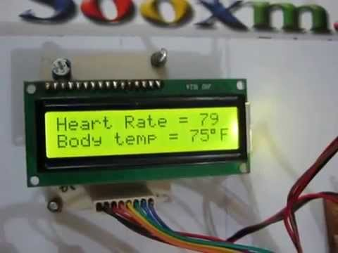
Outline
Introduction
Vital Body Parameters
-Body Temperature
-Heart Rate
-Blood Pressure
Existing Instrumentation
Cuffless Blood Pressure Estimation
High-Level Hardware Block Diagram
High-Level Software Block Diagram
Timeline
Budget
Risks and Mitigation
Final Thoughts

Slide 4
Introduction
All the knowledge obtained in the program is used for this project.
Go through the process of designing, developing, building and testing your own product.
Objective:
-Design and build an accurate, reliable and low cost health monitoring system that measures body temperature, heart rate and blood pressure.
Constraints:
Must use microcontroller.
Must have graphical user interface (GUI).
Must design and build daughter board.
Must be safe to use since it will interact with the body.

Slide 5
Vital Signs
Three vital signs regularly monitored by medical professionals and healthcare givers are:
-Body Temperature
-Heart Rate
-Blood Pressure

Slide 6
Vital Signs (cont’d)
Body Temperature:
-Body temperature depends on many aspects such as level of activity, time of day etc.
-Normal values typically range from 36 to 37 degrees Celsius.
Heart Rate:
- The heart rate is the number of times a persons heart beats per minute.
-Target heart rate at 50 to 85 % effort in adults is anywhere between 85 to 160 beats per minute.
Blood Pressure:
-Measurement of the force exerted on the walls of the blood vessels during contraction phase (systolic) over relaxation phase (diastolic).
-Normal values range from 120/80 to 140/90.

Slide 7
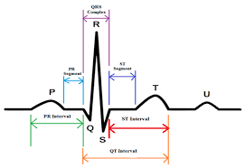
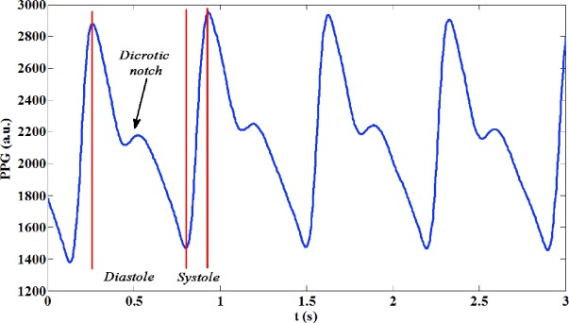
Existing Instrumentation
Electrocardiography (ECG or EKG):
-Process of recording electrical activity of the heart over a period of time using electrodes placed on the body.
Photoplethysmography (PPG):
-Optical technique that is used to detect blood volume changes in the human tissues.
- PPG is often obtained by using a pulse oximeter.
Note* Both can be used to measure heart rate but ECG will be used.

Slide 8

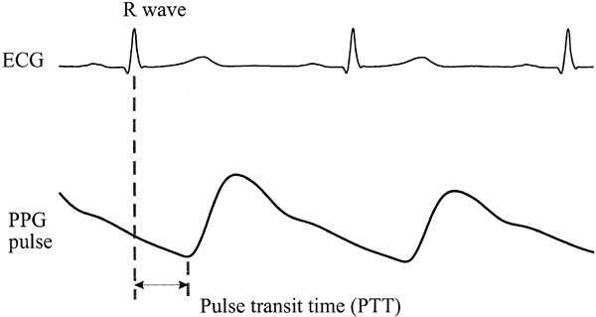
Cuffless Blood Pressure Estimation
By using both a ECG and PPG, it is possible to estimate blood pressure relatively accurately.
Formula for blood pressure (BP):
-Pulse Transmit Time (PTT) found with both ECG and PPG
-HR is obtained from ECG
-BPn-1 is the previously estimated BP
-a,b,c and d can be found with the least
square method.

Slide 9
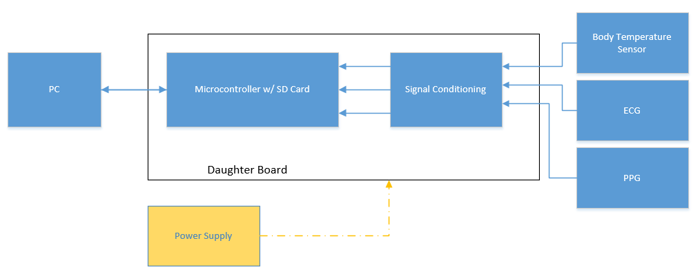
High-Level Hardware Block Diagram

Slide 10
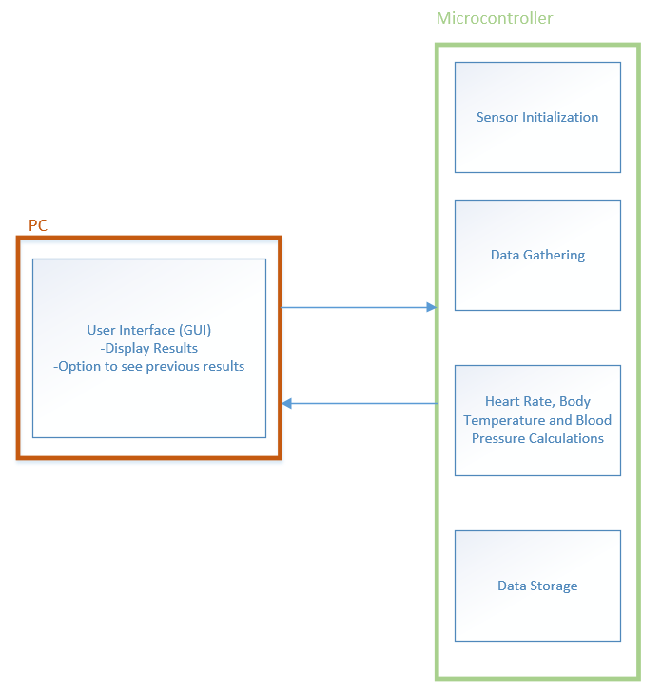
High-Level Software Block Diagram

Slide 11
Timeline
Major milestones for Fall 2017 semester:
-Design Phase October 11th, 2017
-Software Plan October 26th
-Parts and Components Ordered November 2nd, 2017
-Functional Breadboard Prototype November 15th, 2017
-Tested Daughter Board November 29th, 2017
-Design Report December 11th, 2017
..\New Gant Personal Health Monitor.gan

Slide 12
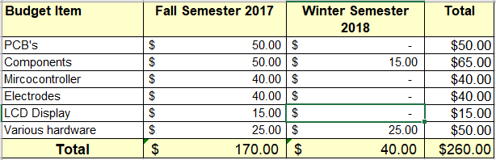
Budget
Budget for this project: $260.
Budget breakdown per semester:

Slide 13
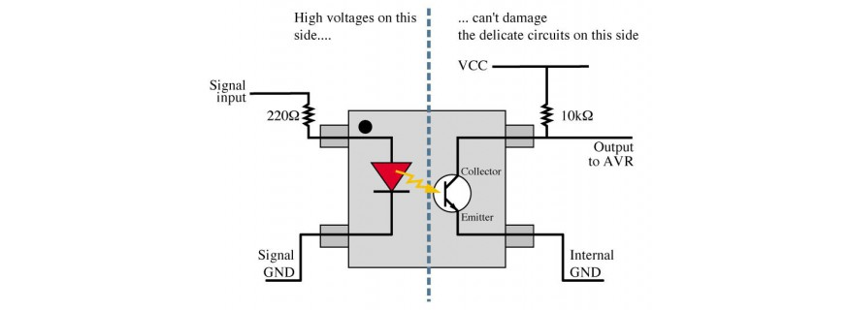
Risks
Falling behind schedule.
Mitigation: working over time to catch up.
Components arriving late.
Mitigation: Using parts from the school.
Sensors not being as accurate as possible.
Mitigation: Initialize and calibrate sensors every time a test begins.
Sensors being safe to place on body.
Mitigation: Use diodes in sensor circuit to provide some over-voltage protection. Could also use opto-isolator integrated circuit which transfer electrical signals between two isolated circuits using light (LED and phototransistor).

Slide 14
Final Thoughts
Questions or Comments?
Thank You.

